Slide 1

Résumé d’enquête : salle de sport
Yosri Saadi M1 BIG DATA
https://docs.google.com/forms/d/e/1FAIpQLSfCQQNK7GKX2nfi66wi3_d5UYqh-1hu5mA3WcSmHuKXsOhH5g/viewform?usp=sf_link

Slide 2
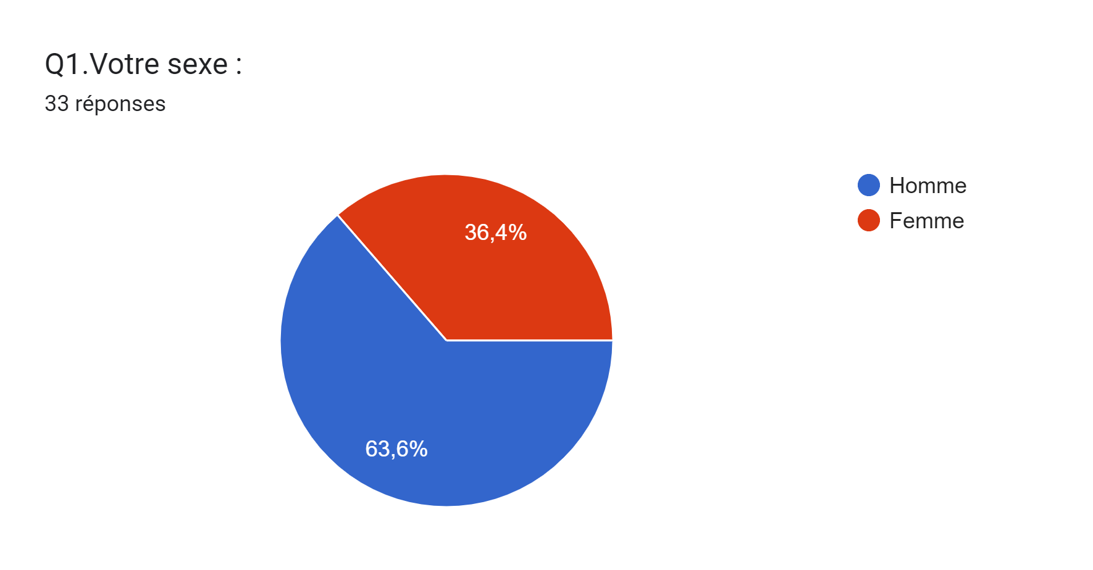

Slide 3
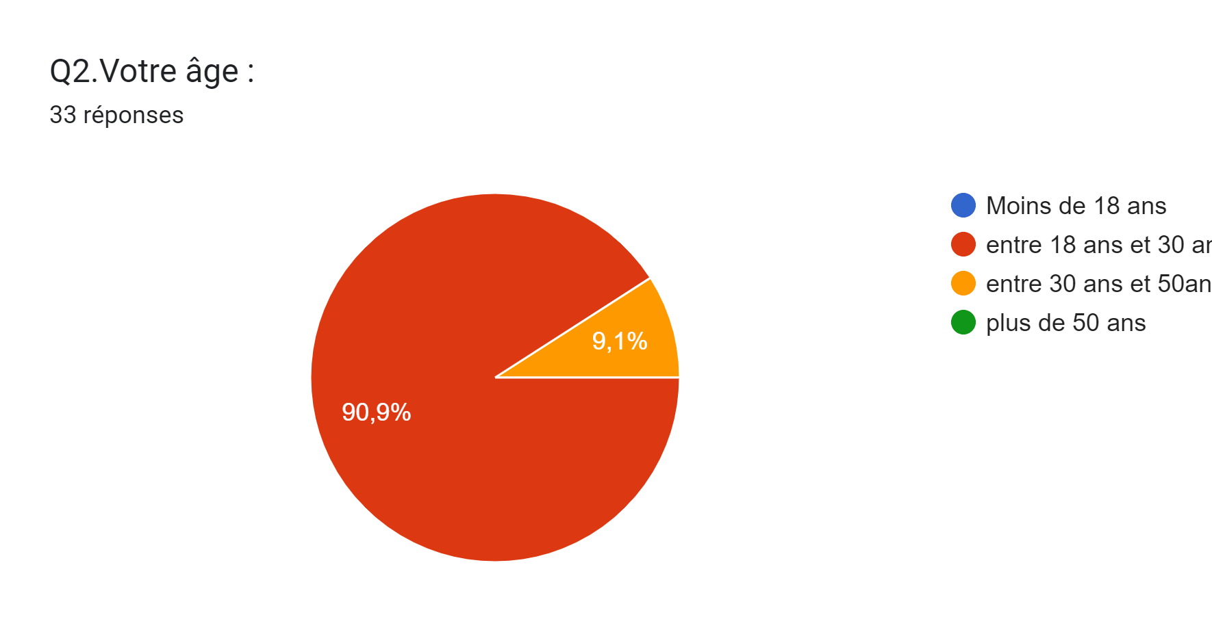

Slide 4
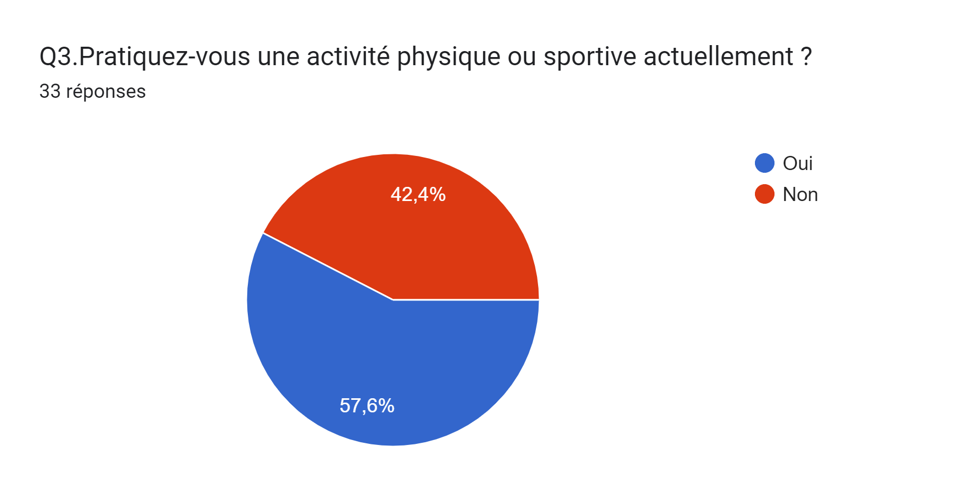

Slide 5
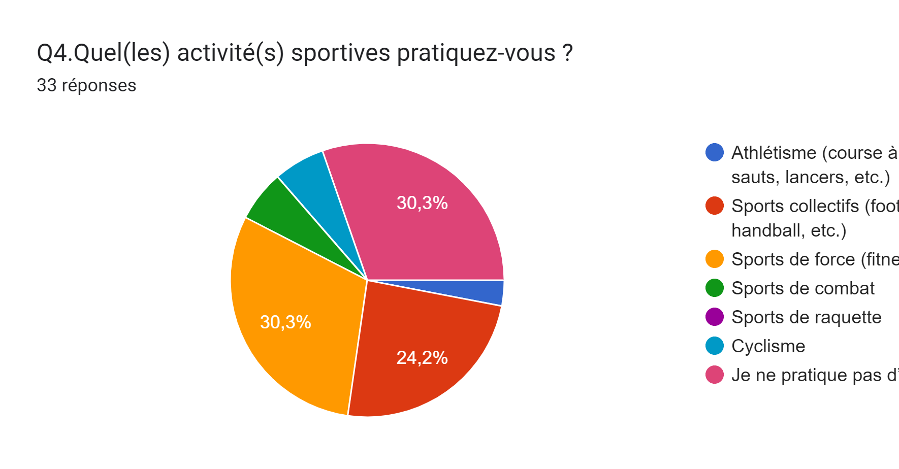

Slide 6
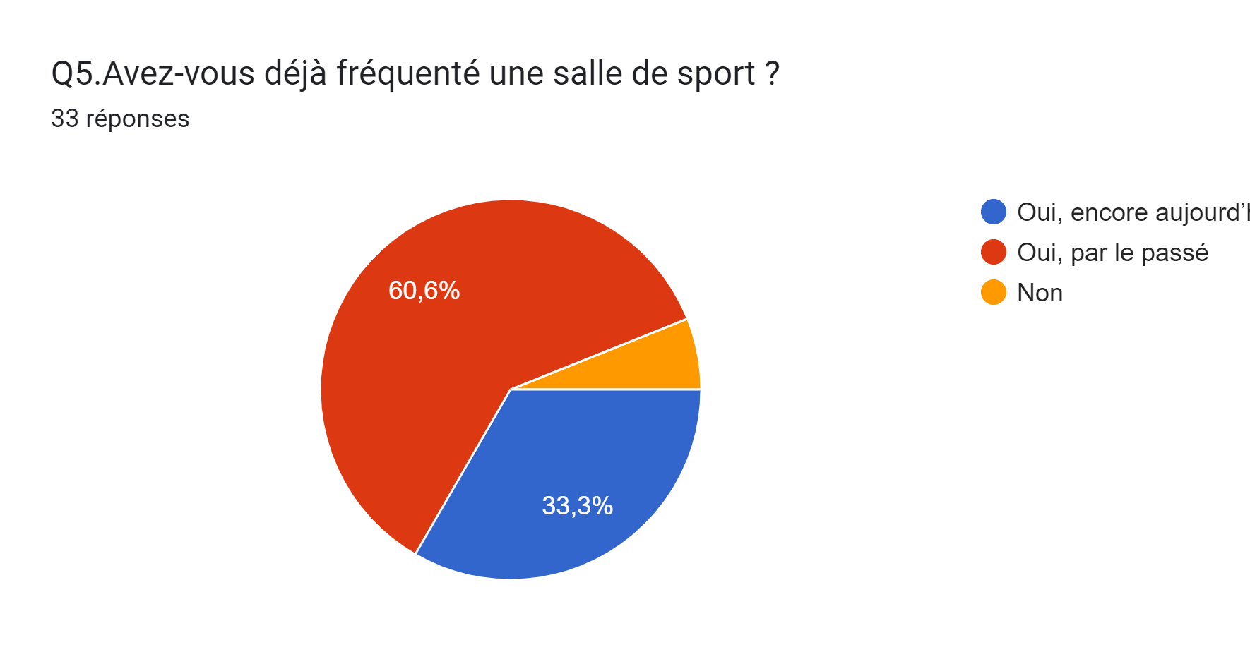

Slide 7
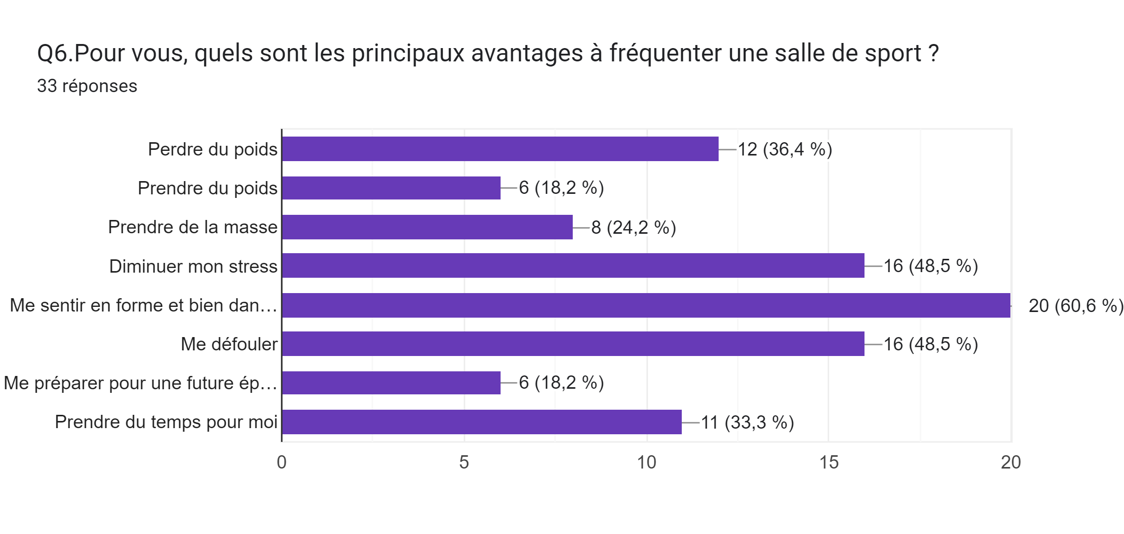

Slide 8
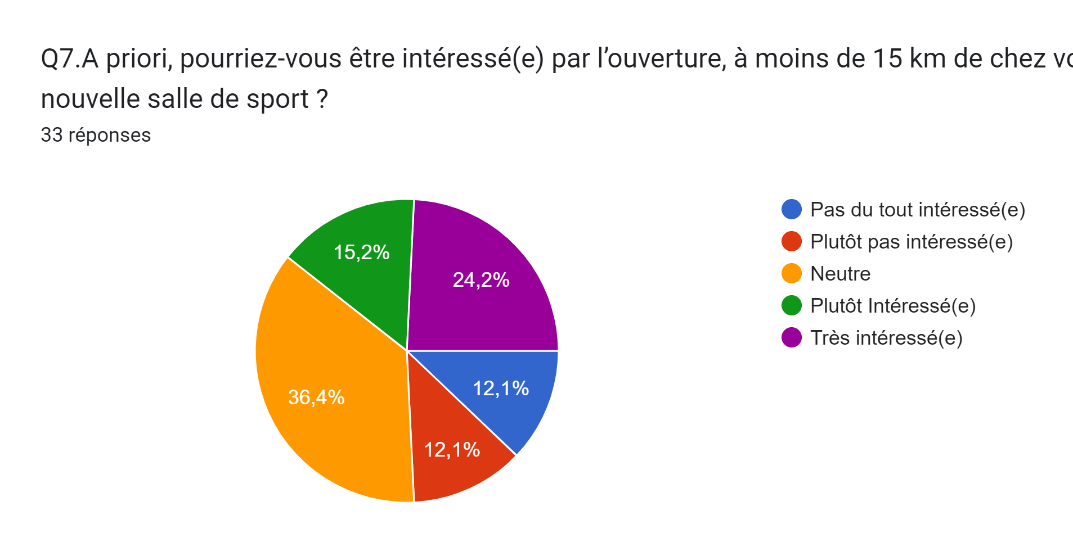

Slide 9

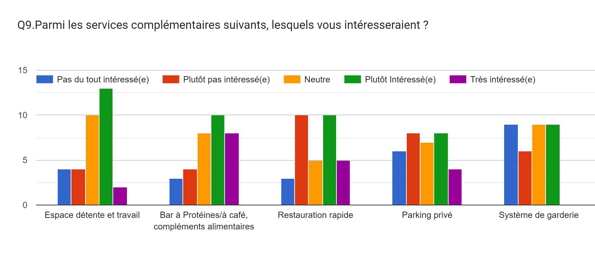

Slide 10
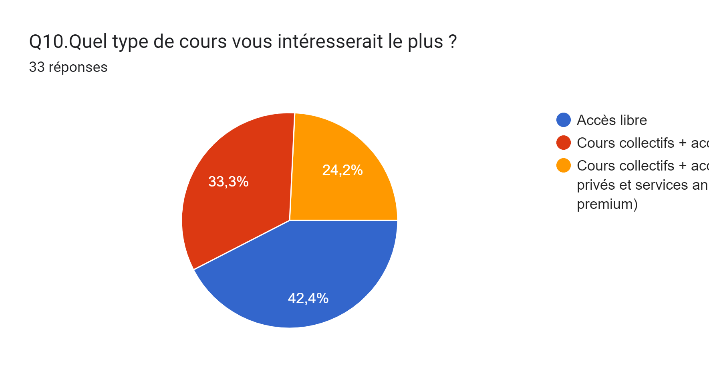

Slide 11

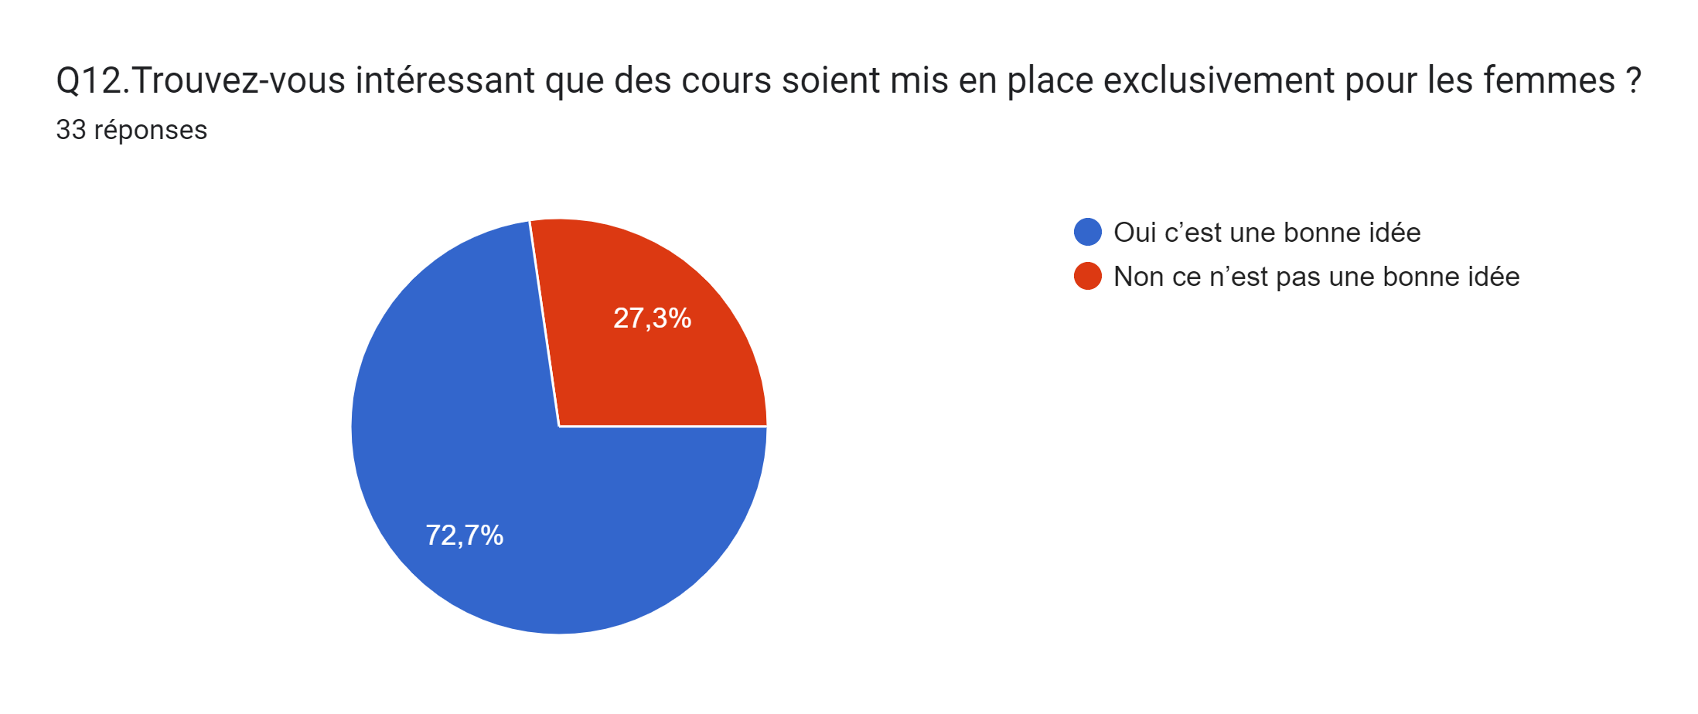

Slide 12
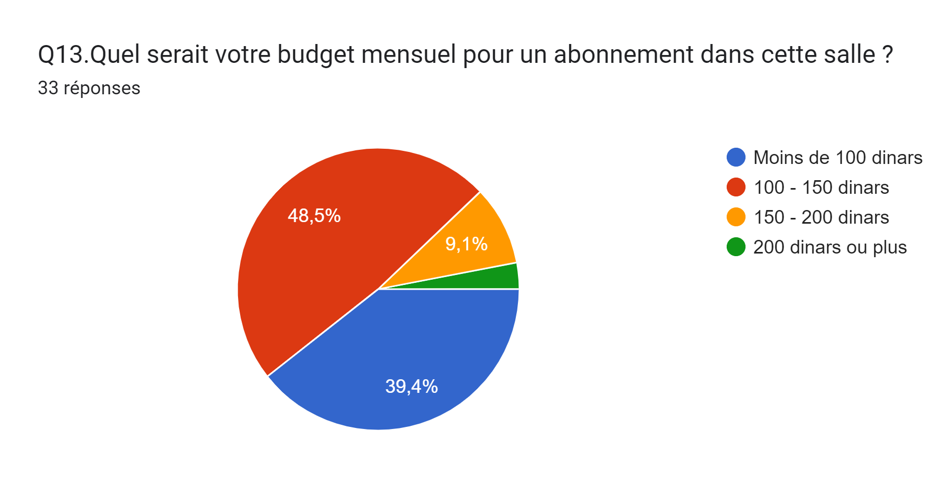

Slide 13
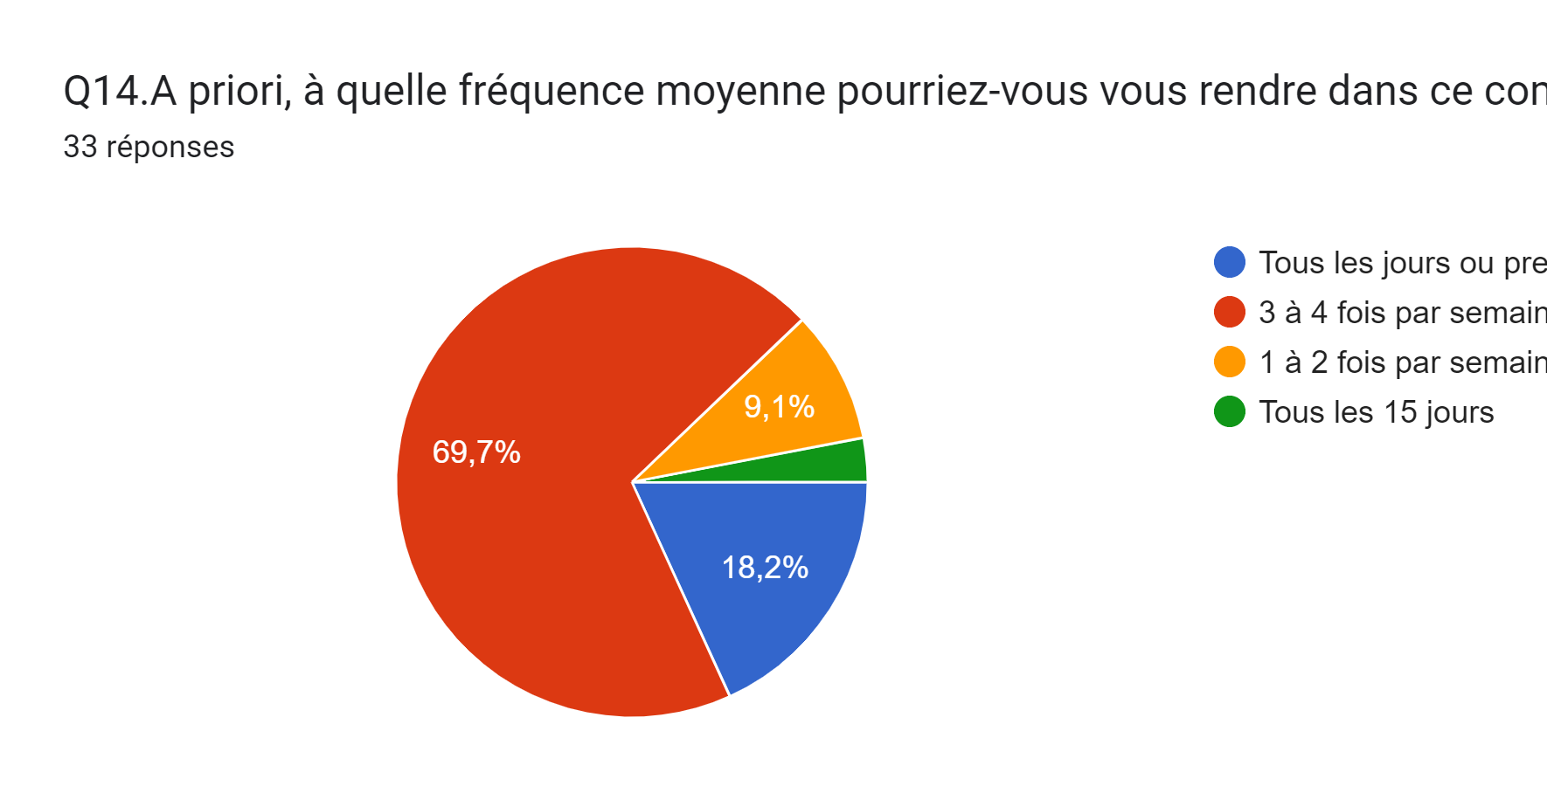

Slide 14
